Slide 1
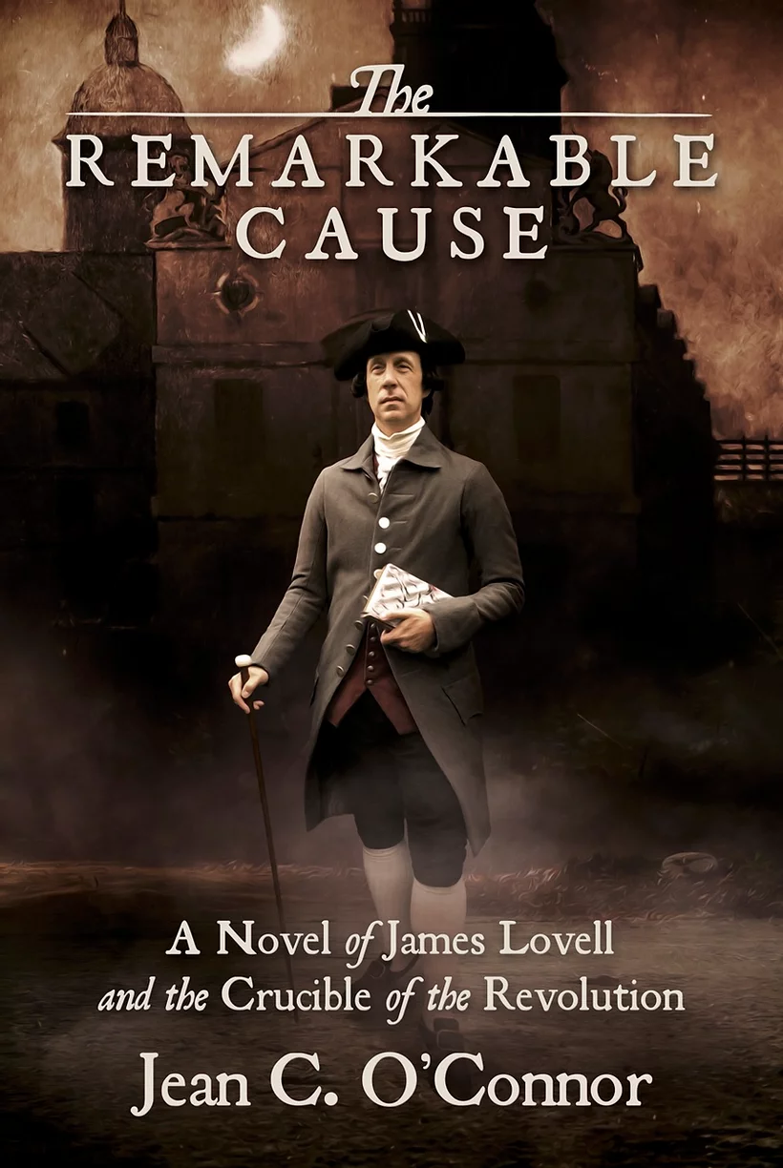
Write the Revolution: The Boston Massacre
A Reading and Writing Experience
MFPE 2024
Jean C. O’Connor
Recipient of the NCTE High School Teacher of Excellence
Author of The Remarkable Cause: A Novel of James Lovell and the Crucible of the Revolution and Congress’s Cryptographer: A Novel of James Lovell and the American Revolution
Contributor to the Journal of the American Revolution
Webinar for Fort Ticonderoga
Presentation for the Museum of the American Revolution, Philadelphia
MATELA Member
The Boston Massacre
March 5, 1770
This reading and writing experience will help students grades 7 - 12 recognize the importance of the Boston Massacre of March 5, 1770, through study of the situation, reading a chapter from The Remarkable Cause: A Novel of James Lovell and the Crucible of the Revolution (Knox Press 2021), used with permission, and writing, for which choices are offered.
Three Handouts:
“Boston Discusses the Massacre” ~ A chapter as story. It
includes guiding questions, facts, vocabulary, and the reading.
“Handouts: Primary Sources”
“Writing for the Boston Massacre”
THIS POWERPOINT is on jeanoconnor.com,
ready to download.

Slide 2
“Boston Discusses the Massacre” ~ A Chapter as Story
Tax disputes and clashes over self-government with Britain have been ongoing for over a decade.
In this first overt clash between colonists and British power, a group of British soldiers fire on an angry mob, resulting in the deaths of five citizens. The response of the town of Boston is significant, revealing the importance town officials place on law, rather than emotion. The situation in Boston in March, 1770, is brought to life in this reading as conflict escalates between the townspeople and the British.
The setting is the Boston Latin School; the characters are Master John Lovell of the Boston Latin School and his son James Lovell, who teaches alongside his father in the big square room on School Street.

Slide 3
PRIMARY SOURCES
PAUL REVERE’S ENGRAVING FROM THE BOSTON GAZETTE,
MARCH 12, 1770
"The bloody massacre perpetrated in King Street,
Boston, on March 5th, 1770 by a party of the 29th Reg.t."
A SHORT NARRATIVE OF THE HORRID MASSACRE
IN BOSTON, Perpetrated in the evening
of the fifth day of March, 1770….
CAPTAIN THOMAS PRESTON’S STATEMENT
IN THE BOSTON GAZETTE
Excerpts from
A Short Narrative,
Boston’s collection
of depositions
of witnesses
to the Massacre.

Slide 4
PAUL REVERE’S ENGRAVING MARCH 12, 1770
On Monday the 12th of March, a week after the events of the Boston Massacre, Paul Revere’s engraving memorializing the four who had died in the conflict by that date appeared in the newspaper.
As you read the Boston Gazette’s description, you will notice that a letter that looks like an “f” appears. In the times of the Revolution, the letter that looks like an “f” where an “s” should be is an archaic form of the “s,” called the “long s.” It was used to replace the single “s” or the first “s” in a word with a double “s.” Read these just as you would an “s.” Punctuation and spelling were sometimes different in the 1700’s, as well.
What words can you find that are colorful, intended to create emotion? What emotion do they provoke? What would be the result of printing this image and these words?
Revere, Paul, Engraver. “Four coffins of men killed in the Boston Massacre.” Boston Gazette, 12 March 1770, Early American Imprints,
Boston Public Library, 29 March 2012. From NewsBank, Inc. and the American Antiquarian Society. All Rights Reserved

Slide 5
“The bloody massacre perpetrated in King Street”
Paul Revere created this engraving
just three weeks after the Massacre
of March 5, 1770. His purpose was
to create a propaganda piece
intended to stir up feelings
of anger against the British
and further the cause of independence.
Consider the composition of the scene.
In front of the Boston State House, the
soldiers, assembled in a line, fire
aggressively into a peaceful crowd.
Was this the actual way this situation
probably developed? Why or why not?
What is the name of the building just
behind the soldiers? What else do you
see in this image?
How many people appear to be injured?
What does the captain appear to be doing?
What emotions are depicted on the faces
of those in the crowd?
Why do you think the little dog stands
out, peaceful and unthreatened?
How does viewing this picture make you feel about the soldiers? The crowd of people?
Paul Revere closely copied an engraving very similar to this by Henry Pelham. Could he have done this today?
"The Bloody Massacre.jpg." Wikimedia Commons, the free media repository. 25 Sep 2021, https://commons.wikimedia.org/
The Miriam and Ira D. Wallach Division of Art, Prints and Photographs: Picture Collection, The New York Public Library. “The bloody massacre perpetrated in King Street, Boston on March 5th, 1770 by a party of the 29th Regt,” The New York Public Library Digital Collections.

Slide 6
CAPTAIN THOMAS PRESTON’S STATEMENT IN THE BOSTON GAZETTE
The statement below shows the words of Captain Thomas Preston that appeared in the Boston Gazette following the event of the Massacre. He wrote it from the Boston Jail on Monday the 12th of March.
Try to read it in the original print version.
Below the Gazette’s words, Preston’s statement is given in today’s standard English.
In the times of the Revolution, the letter that looks like an “f” where an “s” should be is an archaic form of the “s,” called the “long s.” It was used to replace the single “s” or the first “s” in a word with a double “s.” Read these just as you would an “s.”
What seems to be the captain’s main point? How would the inhabitants of Boston have reacted to this statement? Can you find words which were spelled differently in 1770?
Preston’s close, “much obliged and most obedient humble servant,” was one used by government officials, lawyers, military personnel, and most often used in formal letters.
Boston Jail, Monday, 12th March 1770.
Mr. Edes & Mr. Gill,
Permit me through the channel of your paper to return my thanks in the most public manner to the inhabitants in general of this town—who, throwing aside all party and prejudice, have with the utmost humanity and freedom sent forth advocates for truth, in defense of my injured innocence, in the late unhappy affair that happened on Monday night last; and to assure them, that I shall ever have the highest sense of the justice they have done me, which will be ever gratefully remembered, by
Their much obliged and most obedient humble servant,
THOMAS PRESTON
“Permit Me Through the Channel of Your Paper.” Supplement to the Boston Gazette, 12 March 1770, Early American Imprints, Boston Public Library, 29 March 2012. From Newsbank, Inc., and the American Antiquarian Society. All Rights Reserved.

Slide 7
A SHORT NARRATIVE OF THE HORRID MASSACRE IN BOSTON
Read from the introduction to A Short Narrative, Boston’s collection of depositions of witnesses to the Massacre.
It may be a proper introduction to this narrative, briefly to represent the state of things for some time previous to the said Massacre; and this seems necessary in order to the forming a just idea of the causes of it.
At the end of the late war [the French and Indian War], in which this province bore so distinguished a part, a happy union subsisted between Great Britain and the colonies. This was unfortunately interrupted by the Stamp Act; but it was in some measure restored by the repeal of it. It was again interrupted by other acts of parliament for taxing America….
[Here follows a description of the problems caused by the taxes.]
Unfortunately for us, [the commissioners’ complaints about the colonists sent to Parliament] have been too successful in their said representations, which, in conjunction with Governor Bernard's, have occasioned his Majesty's faithful subjects of this town and province to be treated as enemies and rebels, by an invasion of the town by sea and land to which the approaches were made with all the circumspection usual where a vigorous opposition is expected. While the town was surrounded by a considerable number of his Majesty's ships of war, two regiments landed and took possession of it; and to support these, two other regiments arrived some time after from Ireland; one of which landed at Castle Island, and the other in the town.
Thus were we, in aggravation of our other embarrassments, embarrassed with troops, forced upon us contrary to our inclination—contrary to the spirit of Magna Charta— contrary to the very letter of the Bill of Rights, in which it is declared that the raising or keeping a standing army within the kingdom in time of peace, unless it be with the consent of parliament, is against law, and without the desire of the civil magistrates, to aid whom was the pretense for sending the troops hither; who were quartered in the town in direct violation of an act of parliament for quartering troops in America….

Slide 8
READ “BOSTON DISCUSSES THE MASSACRE,”
A CHAPTER FROM THE REMARKABLE CAUSE:
A NOVEL OF JAMES LOVELL AND THE CRUCIBLE
OF THE REVOLUTION
REVIEW Guiding Questions and Facts, followed by Primary Sources, before Reading. Following the Reading, discuss the Questions with the class.
Guiding Questions:
What was the first overt clash between colonists and British power before the beginning of the Revolutionary War? Why was it important?
How and why was British law critical to colonial leaders following the violent incident known as the Boston Massacre?
The Boston Massacre: The Facts
Tensions escalated between British soldiers posted in Boston to enforce taxes and workers in the town during 1770.
On the evening of March 5, 1770, a group of twenty or thirty sailors and ropemakers confronted a soldier, Private Hugh White, posted at the Boston Custom House.
The crowd pelted White with snowballs, ice, sticks, and verbal taunts.
As the crowd grew to more than fifty, Captain Thomas Preston and eight soldiers came to White’s assistance.
In the confrontation, though Captain Preston gave no order, shots were fired. The first shots killed three: Crispus Attucks, a fugitive slave of mixed race who worked as a sailor; a rope maker, Samuel Gray; and a sailor, James Caldwell. The next day another died, Samuel Maverick, followed a couple weeks later by Patrick Carr.
To keep the peace with the British, Boston’s government determined to hold trials. John Adams, lawyer, defended the soldiers; Robert Treat Paine, a friend of Adams, acted as prosecutor. • A collection of depositions of witnesses to the event titled A Short Narrative of the Horrid Massacre was published by the Boston town meeting.
As propaganda for the cause of liberty, Paul Revere created a celebrated engraving of the Massacre.
In October of 1770, Captain Thomas Preston was acquitted of charges he had ordered the soldiers to fire.
In November, six of the eight soldiers were acquitted. Two were found guilty of manslaughter because there was evidence they had fired into the crowd. However, the two were let go after pleading benefit of clergy, an old practice in which they recited a scripture verse and had their thumbs branded.

Slide 9
Boston Discusses the Massacre
April 15, 1770
“Listen to this,” James said. It had been a full day at school. Classes had gone well with a few interruptions from Francis, who had a violent cough, and Charles, who had to run outside twice with an upset stomach. Otherwise, the boys worked diligently, and for once James had no need to threaten or chastise the scholars for want of effort.
Now it was nearly dismissal time. James had just finished reading A Short Narrative of the Horrid Massacre, the town’s collection of depositions for witnesses and participants in the Boston Massacre. Shortly after the dreadful events, the town meeting had chosen Joseph Warren, James Bowdoin, and Samuel Pemberton to obtain the facts of the situation. They had turned over the task of getting depositions to justices of the peace, who had taken ninety-six statements.
Of course, the goal of A Short Narrative of the Horrid Massacre was to convince the townspeople of the guilt of the soldiers. Even though copies were not to be distributed within Boston, town officials reasoned that providing copies for neighboring towns would do just as well for release of information. While he usually did not talk about happenings in the town at school, James decided to discuss A Short Narrative with the students.
“Tell me what you think of this,” James said. The boys stopped their reviews of the assigned readings, shut their books, and turned to him, their attention focused.
James read a statement aloud from the introduction to A Short Narrative of the Horrid Massacre: “‘While the town was surrounded by a considerable number of his Majesty’s ships of war, two regiments landed and took possession of it; to support these, two other regiments arrived some time after from Ireland: one of which landed at Castle Island, and the other in the town.’”
“The troops stayed here for nearly two years,” said Lewis, a lively boy in the second form.

Slide 10
EXPERIENCING THE BOSTON MASSACRE:
A NARRATIVE WRITING
To help you understand more fully the motives, emotions, and decisions of those affected by the Boston Massacre, as well as consider its lasting impact, you will create a narrative writing.
The narrative is guided by the acronym RAFTS, standing for Role, Audience, Format, Topic, and Strong Verb. See the next slide for details.
EXPERIENCING THE BOSTON MASSACRE:
PARAGRAPH OR ESSAY WRITING
Argumentative:
Make a claim about the effectiveness of the way James handled the dispute about British policies with his father, Master Lovell, and provide evidence to support your claim.
Explanatory:
How does this excerpt show that despite disagreements with British policy, especially taxation, the colonists still support British law?
Narrative:
Take the viewpoint of any of the characters introduced in this reading, and write a journal entry, speech, or letter from that character, explaining these events and giving your opinion about them.

Slide 11


RAFTS
Write the Revolution:
The Boston Massacre
Your role will be a bystander, a participant in heckling the soldiers, a British soldier, Captain Preston, a newspaper journalist writing about the event of the Massacre or about the trial, a student in the Boston Latin School, James Lovell, his father, Master John Lovell, or another individual affected by the events of the Boston Massacre. You will assume that role and write as if you were that person.
R
A
Your audience could be a friend, your diary, your journal, someone in the future, readers of the newspaper, a family member, or James Lovell or Master John Lovell, teachers at the Boston Latin School.
F
The format of your writing could be a journal, letter, speech, editorial, diary, or sermon — Any prose form.
T
The topic will be your reflections on the Massacre.
S
The strong verb guiding your writing reflects your purpose: explain, persuade, describe, reflect, analyze, or consider.

Slide 12
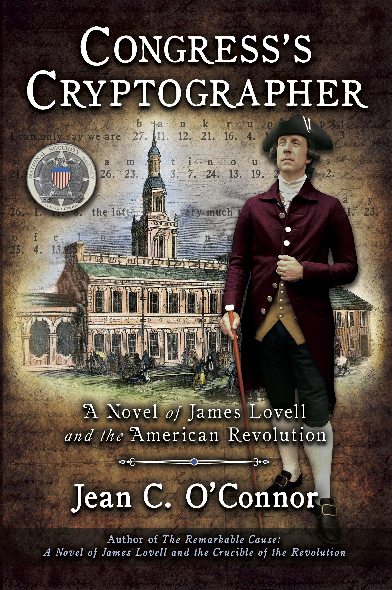
CONGRESS’S CRYPTOGRAPER:
A NOVEL OF JAMES LOVELL AND THE AMERICAN REVOLUTION
CONGRESS'S CRYPTOGRAPHER is the compelling, eye-opening historical novel of James Lovell, America's first Foreign Affairs Secretary, during the tumultuous days of the Revolutionary War.
Revealing his immense talent at decoding British cipher, James Lovell creates a surprising portal to the enemy’s plans, inspiring the gratitude of Generals Washington and Greene.
Richly researched with hundreds of original sources and letters, and illustrated with startling images of James Lovell’s cipher, Congress’s Cryptographer portrays the former Boston schoolteacher’s relentless determination to seek a better life for his country.
It is no wonder that the long-time head of the National Security Agency called James Lovell, “the Revolution’s one-man National Security Agency.” Truly, in this world a spy, a code, or a secret could change everything.
Amazon, Barnes and Noble, your local bookstore
Mountain Pine Press, 2024

Slide 13

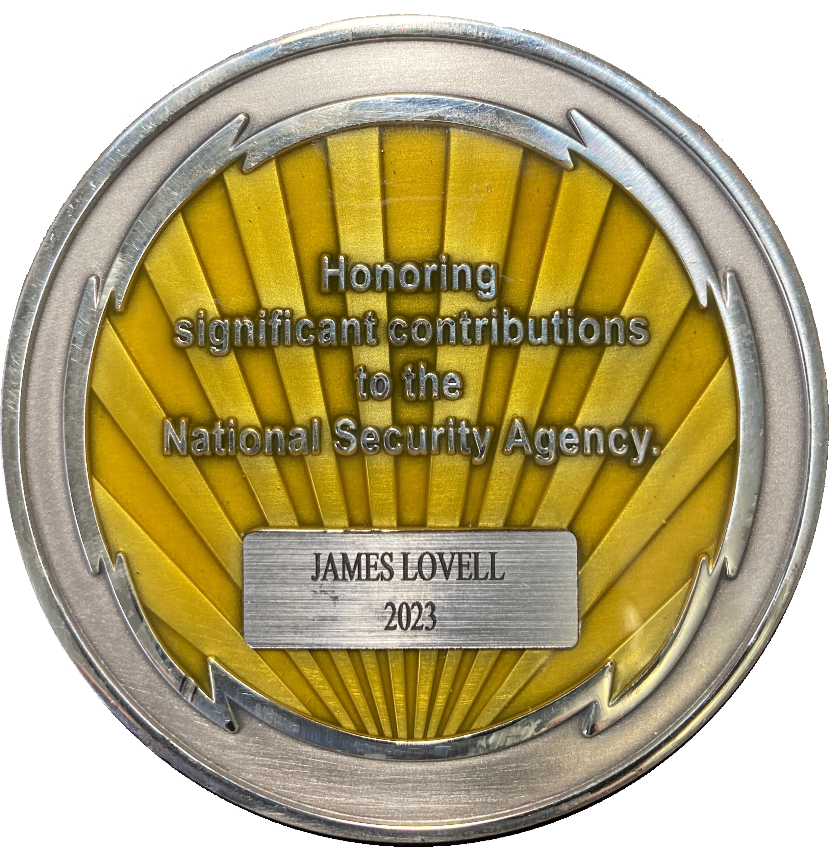


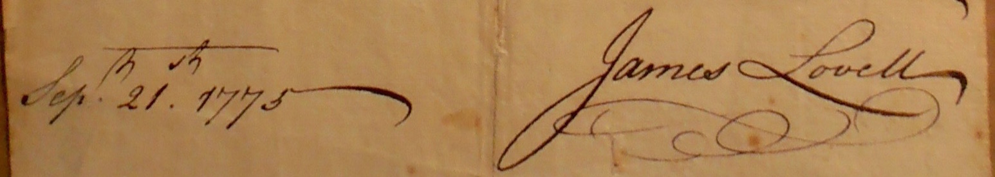
CHECK IT OUT!
Visit
jeanoconnor.com
For order information.
Link to Press Release from National Security Agency: James Lovell’s induction into the Cryptologic Hall of Honor, Jan. 2024.
Study Guide
Writing Ideas
Sites for Research
Thinking/Discussion Questions
Images of Satire
The News of the Day
Knox Press (2021)
Mountain Pine Press (2024)

